Slide 1
Sudoku solver
Obada Saleh
Hamza Farhat

Slide 2
Goals Of project
Learn new high level language (PYTHON).
Learn image processing.
Use AI Algorithm.

Slide 3
Python
Python is a popular general purpose programming language used for both large and small-scale applications. Python’s wide-spread adoption is due in part to its large standard library, easy readability and support of multiple paradigms including functional, procedural and object-oriented programming styles. Python modules exist for interacting with a variety of databases making it an excellent choice for large-scale data analysis and the Python programming language is often the choice for introductory courses in data science and machine learning.

Slide 4
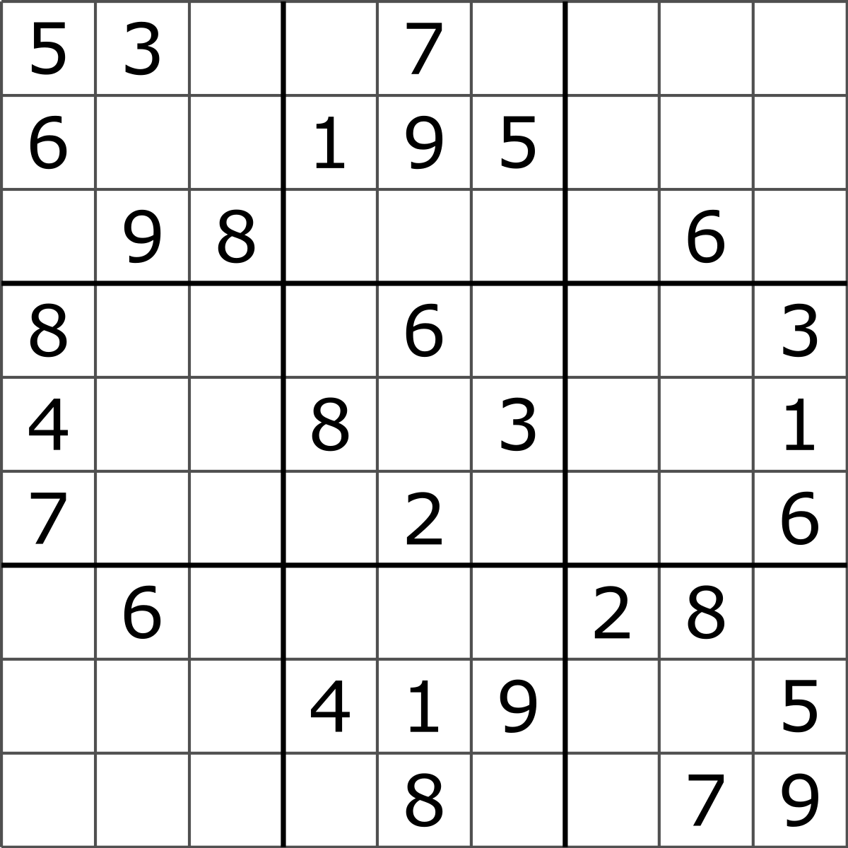
Sudoku game
Sudoku is a logic-based, combinatorial number-placement puzzle. The objective is to fill a 9×9 grid with digits so that each column, each row, and each of the nine 3×3 subgrids that compose the grid contains all of the digits from 1 to 9.

Slide 5
Completed steps
Read image and get the data.
Solve the Sudoku game.
Write the algorithm.
System analysis.
System design.

Slide 6
Bye bye martarmawi

